Slide 1

Models of communication
PG, SEM 1, CSS

Slide 2
Models of Communication
With the passage of time, several theorists developed communication models in attempts to
1. explain the communication process.
2. understand how to improve communication and rhetoric.

Slide 3
Models of Communication
Broader division of modules of communication.
1. Linear Model: focus on one-way communication.
2. Interactional Model: focus on two-way communication.
3. Transactional Model: focus on two-way communication where message gets more complex as the communication event progresses.

Slide 4
Models of Communication
Based on the fundamental models of communication, there were developed some more models of communication, like
Aristotle’s Model.
Lasswell Model.
Shannon –Weaver Model.
Berlo’s S-M-C-R Model.
Osgood –Schramm Model.
Westley and Maclean Model of Communication.
Barland’s Transactional Model of Communication.
Dance’s Helical Model of Communication.

Slide 5
Models of Communication: Aristotle’s Model
Aristotle’s Model of Communication: Linear Model of Communication
Aristotle: ( 384-322 BC) a Greek philosopher and polymath of ancient Greece.
The oldest model of communication aims at how to become a better and more convincing orator/ communicator.
It takes into account- SPEAKER, SPEECH, OCCASION, TARGET AUDIENCE, and EFFECT.
It considers three elements that improve communication- Ethos, Pathos, and Logos .
( Ethos= credible , Pathos= ability to connect, Logos= logical arguments)
No attention to feedback

Slide 6
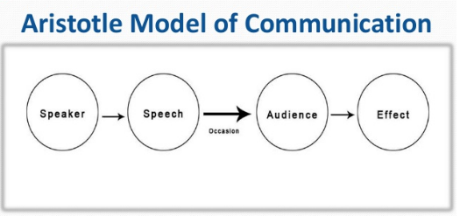
Aristotle and Communication:

Slide 7
Models of Communication: Laswell Model
Harold Dwight Lasswell , an American Political Scientist proposed the Lasswell Model of Communication.
Lasswell Model of Communication: a linear model of communication that analyzes one-way communication.
Its principle: WHO, SAID WHAT, THROUGH WHAT CHANNEL, TO WHOM, WITH WHAT EFFECT?

Slide 8
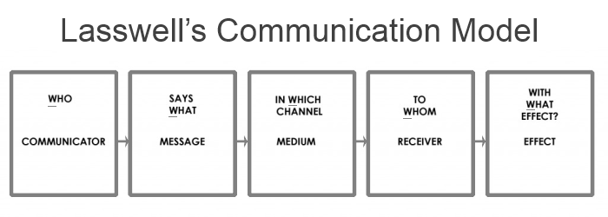
Models of Communication: Laswell Model

Slide 9
Models of Communication: Shannon-Weaver
Shannon-Weaver Model of Communication:
The first model of communication that highlights the role of ‘noise’ in communication.
Its key components: Sender, Encoder, Channel, Noise, Decoder, Receiver.
It focusses on encoding and decoding of the messages.
During encoding and decoding ‘ noise’ ( barrier to communication) occurs that disrupts a message.

Slide 10
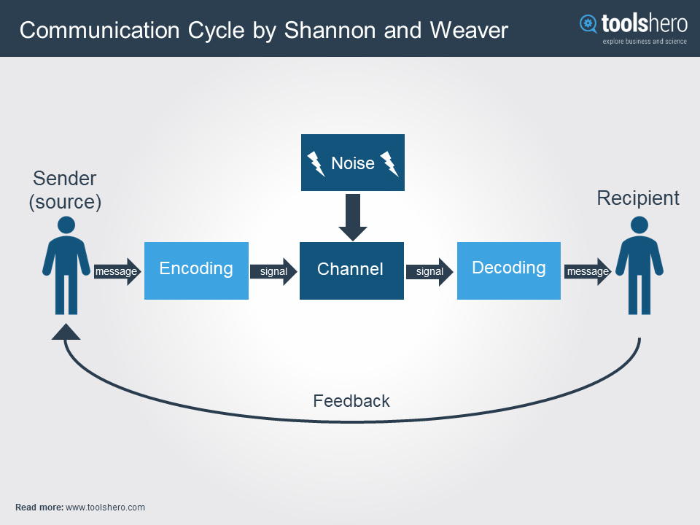
Models of Communication: Shannon-Weaver

Slide 11
Models of Communication: Berlo’s S-M-C-R Model
Berlo’s S-M-C-R Model of Communication:
This model emphasizes S-M-C-R to be the key components of Communication.
S: Source. ( sender, his attitude, his cultural background etc.)
M: Message. (content, structure, code)
C: Channel. (the pathway for communication)
R: Receiver ( receiver, his attitude, his cultural background, knowledge)

Slide 12
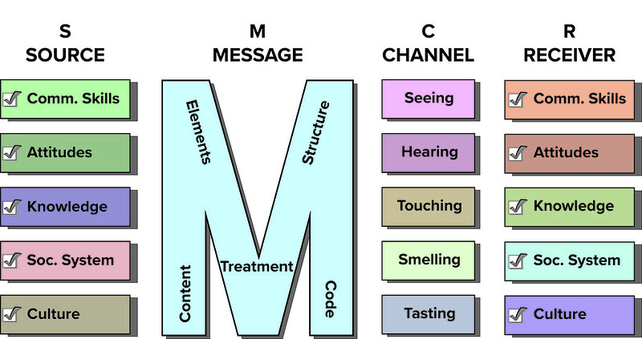
Berlo’s S-M-C-R Model of Communication

Slide 13
Models of Communication: Osgood-Schramm
Osgood- Schramm Model of Communication: an Interactional Model of communication.
A circular model communication that underlines the interactive nature of communication.
Its key points:
1) communication is not linear, but circular.
2) communication is reciprocal and equal.
3) messages are based on interpretation.
4) communication involves encoding, decoding, and interpreting and they are continuous.

Slide 14
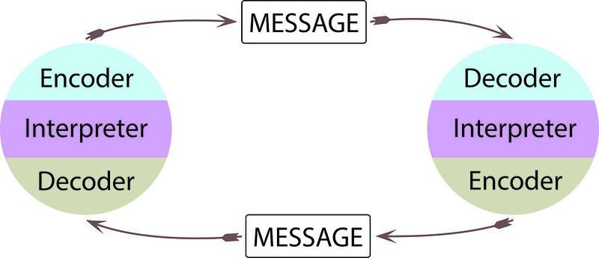
Osgood- Schramm Model of Communication:

Slide 15
Model of Communication: Westley and Maclean
Westley and Maclean Model of Communication:
In 1957 Westley and MacLean’s model of communication is proposed by Bruce Westley (1915-1990) and Malcolm S. MacLean Jr (1913-2001).
This model of Communication classifies communication in two groups:
Interpersonal communication and Mass Communication.
In Interpersonal Communication, the feedback is fast and direct.
In Mass Communication, the feedback is indirect and slow.

Slide 16
Model of Communication: Westley and Maclean
Westley and MacLean believed that communication doesn’t start from day one but actually
begins when the speaker receives signals or messages from his external surroundings.
In this model again the process of initiating communication by first sending messages takes a back seat
It suggests that communication starts with receiving messages from the environment.
This model considers a strong relation between the signals from the surroundings and the process of communication. According to this model the process of communication begins with receiving messages rather than sending messages.
It advocates that communication is influenced by environmental, cultural and personal factors.

Slide 17
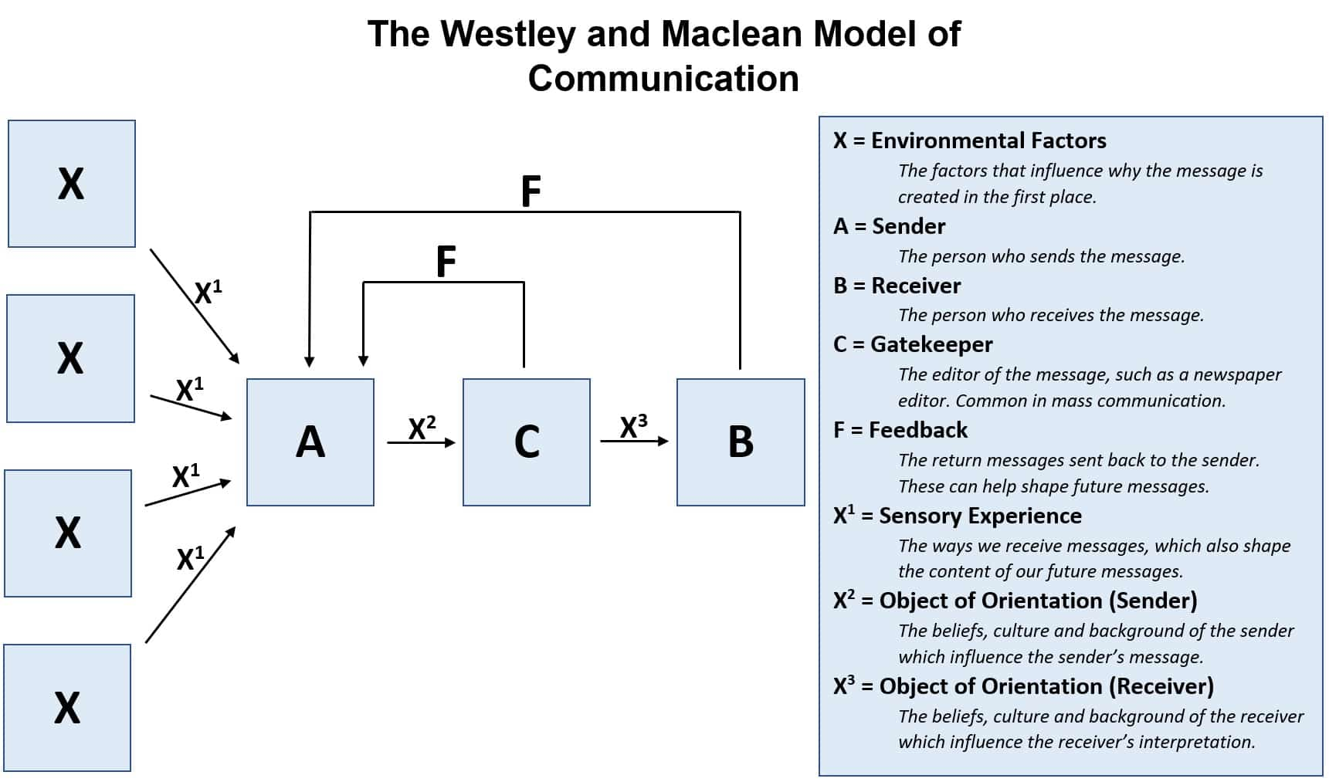
Model of Communication: Westley and Maclean

Slide 18
Model of Communication: Westley and Maclean
Source (A) – Source is the message creator and sender.
Environment (X) – Environment is the physical and psychological situation where the message is being created and sent.
Sensory experience (X1…) – Sensory experience is the first thing that the source sees by which the source gets the idea for the formation of the message.
Objects of Orientation (X1, X2,…) – Objects of orientation is the person’s social and cultural reality that has formed from his/her past experiences and teachings.
Message Interpretation or Coding (X’) – Message is interpreted with the objects of orientation of the receiver of the message.
Receiver (B) – The person who gets the message sent by the source and the person who interprets according to his/her objects of orientation.

Slide 19
Model of Communication: Westley and Maclean
Object of Orientation of Receiver (X, b) – The views and ideas of the receiver or his/her social reality is his/her object of orientation. That is how the receiver interprets the message.
Feedback (f) – The receiver forms another message after interpreting the message and sends it back to the sender. It is known as feedback.
Gatekeeper (C) – Gatekeepers are found in mass communication. The gatekeeper is the editor who filters the message as per the needs of the audience and media institution.
Opinion Leader – Opinion leaders are well known and recognized people who can influence public opinions.

Slide 20
Model of Communication: Westley and Maclean
Example of Westley and MacLean’s Model of Communication
A person ‘A’ is going to a meeting. Thunderstorms ‘X1’ and heavy rains ‘X2’ start. The roads ‘X3’ are all blocked. ‘A’ will have to convey the message to the people who are conducting the meeting that he/she will not be reaching on time. ‘A’ can inform all others through phone.
Here, the message is conceived from the environmental message through the person’s sensory experience. The object of orientation of the person makes him call others because he thinks that reaching late is impolite. Sender ‘A’ creates the message as a courteous request.
The message is coded in a language form and is sent to the receiver ‘B’. ‘B’ interprets according to his/her own object of orientation like the receiver can still find reaching late to a meeting rude. The feedback is given accordingly.

Slide 21
Model of Communication: Westley and Maclean
Daily News Papers will receive many Press releases from Many Public Relations Agencies on behalf of their clients. In this case, News paper will publish the selected Press release due to the space constraints. Then, Readers can directly respond to the client or they can respond to the News daily which published in the Newspaper. If Readers responded to daily News paper, it will communicate the feedback to concern PR Agency.
X1, X2 and X3—are Press Release, Feedback (f), Clients (A), Reader (B) and Daily News Paper (Gate Keeper) (c)
1. Feedback Loop between Reader (B) and News Paper (C) – fBC
2. Feedback Loop between News Paper(C ) and Client (A)- fCA
3. Feedback loop between Reader (B) and Client (A)- fBA

Slide 22
Model of Communication: Westley and Maclean
Merits and Demerits:
This model accounts for Feedback.
It can account for different modes of communication, i.e., for both interpersonal communication and Mass communication.
It is a predictive model of communication and very descriptive also.
It also account for non binary interactions, this means that it will remain good even for communications involving more than two sources.
Westley and Maclean communication model is Two Dimensional.
Too complicated for involving numerous elements in it.
It cannot account for multi dimensions; this means this model will not be applicable for typical communication events that involve broader context and wide range of communication messages.
2

Slide 23
Model of Communication: Barnlund’s Transactional Model of Communication
The 1970 model of transactional communication proposed by Dean Barnlund.
It articulates that sending of the message as well as receiving it happen simultaneously.
This is a continuous process where sender and receiver interchanges their places, and both are equally important. The message passing takes place with a constant feedback being provided from both parties. A feedback for one is the message for the other. In other words, it is a reciprocal process.
This model is made up of public, private and behavioral cues.
(cues: signs for doing something/ public cues: physical/environmental/artificial, private cues : senses of a person both verbal and non-verbal, behavioral: both non-verbal and verbal)

Slide 24
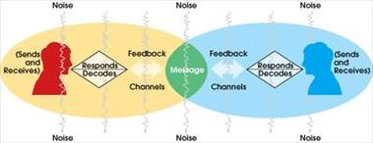
Model of Communication: Barnlund’s Transactional Model of Communication

Slide 25
Model of Communication: Dance's Helical Model
Frank Dance proposed the model of Helix communication in 1967.
The Helical Model of Communication, or Dance’s Helix/ Helical Model, is a communication model in which communication is explained by means of a helix. The Helical Model of Communication is both linear and circular, and stands in contrast to exclusively linear models, or models based on circularity, such as the Aristotle’s communication model, or Berlo’s SBSW model.

Slide 26
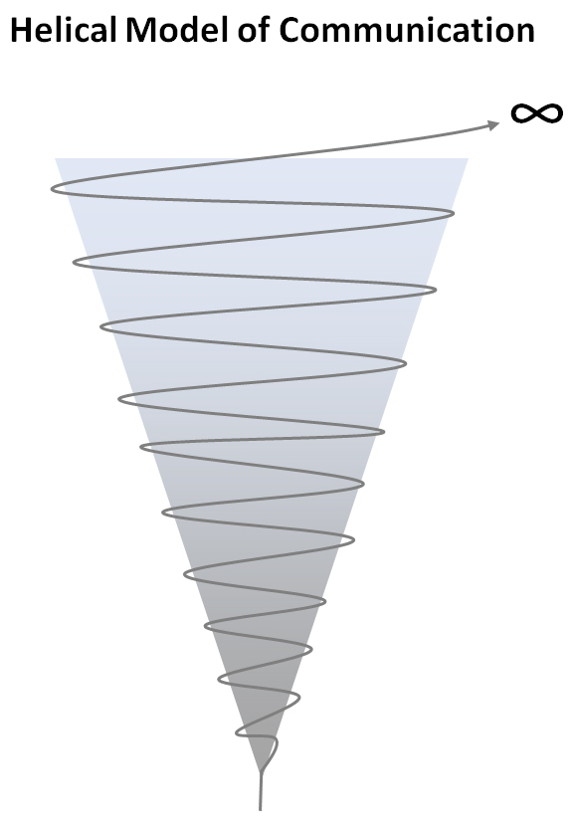
Model of Communication: Dance's Helical Model
Communication , when it begins is small that means communicators share a little information in the initial phase.
It gradually develops and the communicators share more information with the passage of time.

